Slide 1

MRA PROJECT PART-B
BY: YOGESH NEGI

Slide 2
Contents:
Executive Summary of the data
Problem statement
Executive Summary & Data Dictionary
Assumptions about data
Exploratory Analysis & Insights
Weekly, Monthly, Quarterly, Yearly Weekday Trends in Sales count
Products counts & Year Wise top products
Summary and Recommendations
Market Basket Analysis
Market Basket Analysis Meaning
MRA KNIME Work Flow & Qutput Table
Associations Identified
Association Rule Parameters
MRA – values
Association Rules Table
Recommendation
Recommendation
Summary

Slide 3
Agenda:
Executive Summary of the data
Exploratory Data Analysis
Market Basket Analysis
Associations Identified
Recommendation

Slide 4
01 Executive Summary Problem statement Executive Summary & Data Dictionary Assumptions about data

Slide 5

Problem Statement
A grocery store shared the transactional data with you. Your job is to conduct a thorough analysis of Point of Sale (POS) data, identify the most commonly occurring sets of items in the customer orders, and provide recommendations through which a grocery store can increase its revenue by popular combo offers & discounts for customers.

Slide 6
Executive Summary:
Data: from 01-01-2018 to 26-02-2020
Objective: This project involves analyzing Point of Sale (POS) Data to suggest effective combo offers and discounts, enabling a grocery store to elevate revenue by catering to customer preferences and driving sales.
Dataset: 20641 Rows, 3 columns,
Missing values : None
Duplicate values: 4730
Through exploratory analysis and insights, a comprehensive comprehension of the data is achieved, illuminating pivotal sales trends and patterns.
Market Basket Analysis :Conducting Market Basket Analysis with association rules unveiled product relationships within customer purchases..
The analysis revealed frequently co-purchased products, providing insights for crafting attractive customer offers.

Slide 7
Data Dictionary
Date
date of product sold
Order_id
Id of the order
Product
Name of the Product sold

Slide 8

Duplicate Values:
Removing duplicate rows is common for enhanced analysis, but considering shared purchases with customer IDs, retaining duplicates in this dataset ensures vital insights remain unaltered.
Due to the absence of unique identifiers, removing duplicate rows may be unsuitable in this case.
Considering the dataset's structure where rows contain dates, customer IDs, and purchased products – even when the same product is acquired by multiple customers on the same day – dropping duplicates could lead to valuable data loss.
Hence, eliminating duplicate rows might inadvertently result in the loss of meaningful information from the dataset.
Consequently, duplicate values persist without alteration within the dataset.

Slide 9

Assumptions:
The dataset catalogues grocery store purchases on multiple datesEach entry in the data represents a single item purchased.
The initial column denotes the purchase date of each item .
The second column identifies the purchasing customer.
The third column indicates the purchased item.
The dataset allows for multiple customers purchasing the same item on different dates.
No data is available concerning the quantity or price of individual items.
Duplicated values have been retained without removal.

Slide 10
02 Exploratory Data Analysis
Weekly, Monthly, Quarterly, Yearly Weekday Trends in Sales count
Products counts & Year Wise top products
Summary and Recommendations

Slide 11
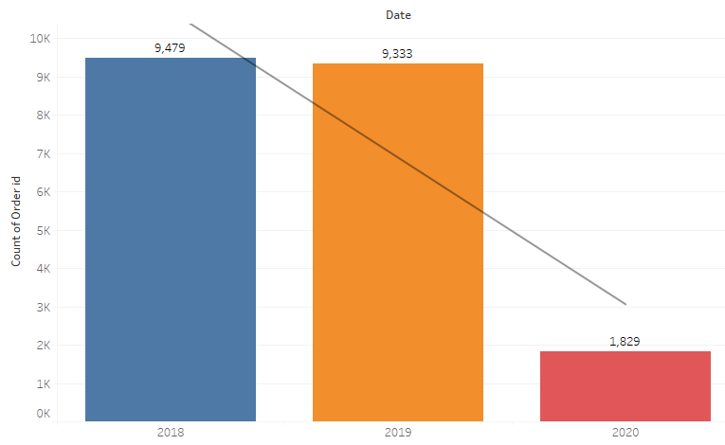
Annual Product Sales Count
Due to data availability until February 26, 2020, the product sales count for the year 2020 appears relatively lower.

Slide 12
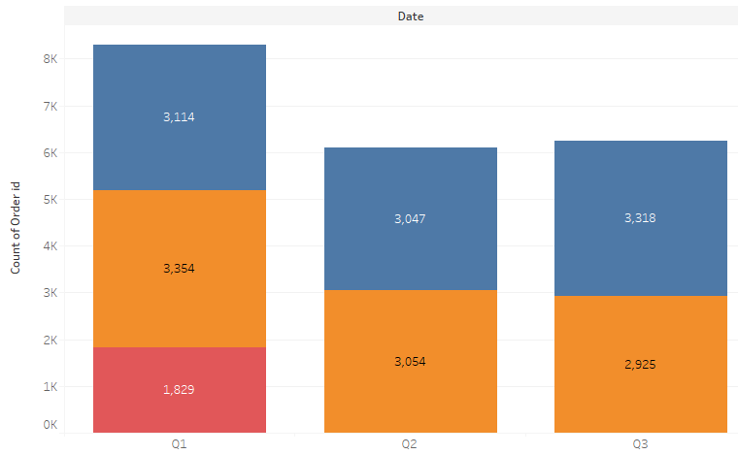
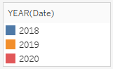
Quarterly Product Sales Count
Given the data available until February 26, 2020, the relatively high product sales count in Q1 is attributable to this timeframe.
The highest sales were recorded in Q1 of 2019.
The peak sales occurred in Q3 of 2018.
The product sales count in Q2 remains approximately consistent between the years 2019 and 2018.

Slide 13
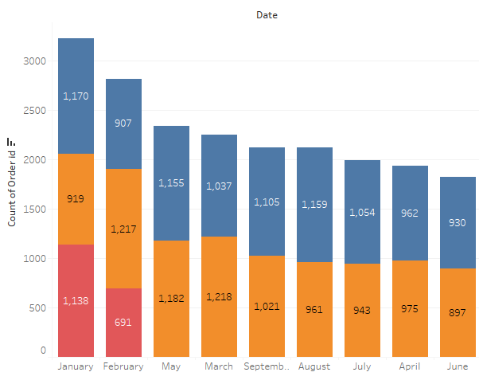
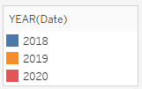
Monthly Product Sales Count
January marked the highest product sales in 2018, while February saw the lowest sales.
March saw the highest product sales in 2019, while January recorded the lowest sales..

Slide 14
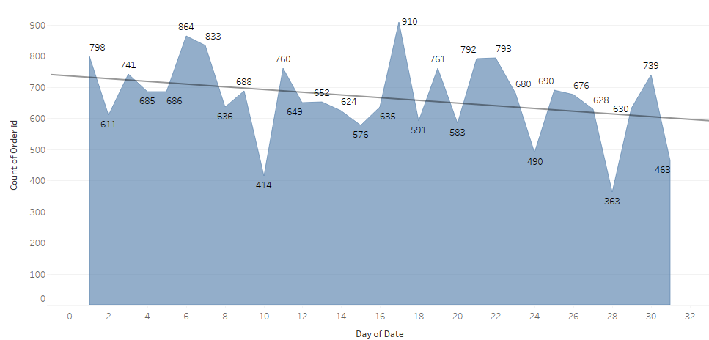
Product Sales Count by Day of the Month

Slide 15
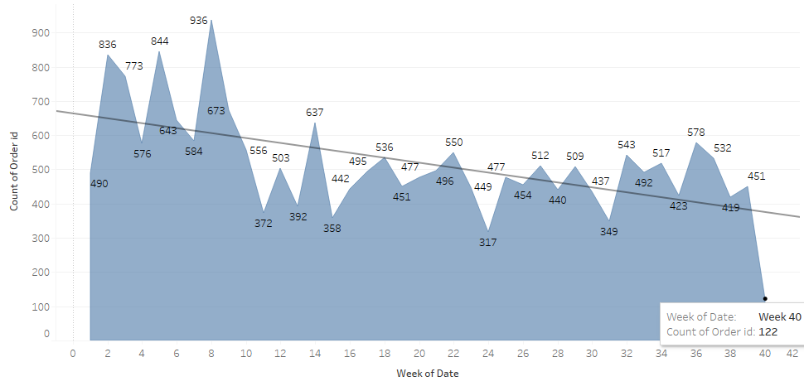
Weekly Product Sales Count

Slide 16
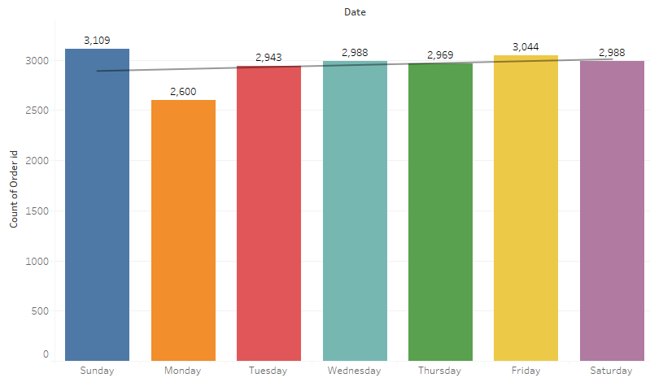
Weekday Count of Products Sold
Most of the products were sold on Sundays.
Least products were sold on Mondays.
On other days sales in consistent.

Slide 17
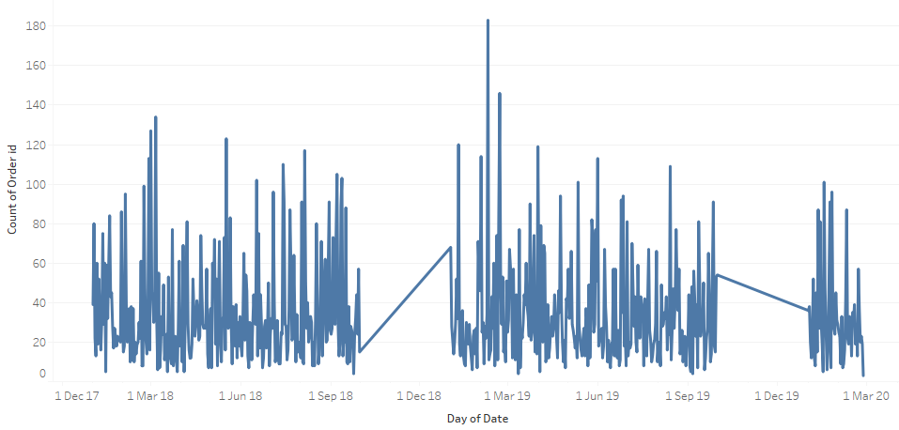
Daily Sales Count

Slide 18
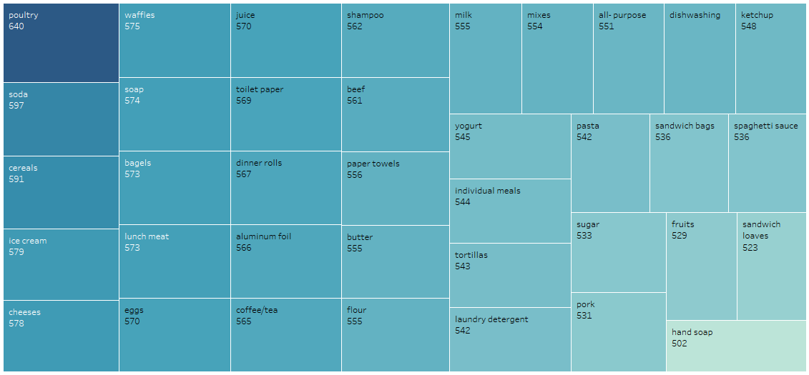
Product Sales Count

Slide 19
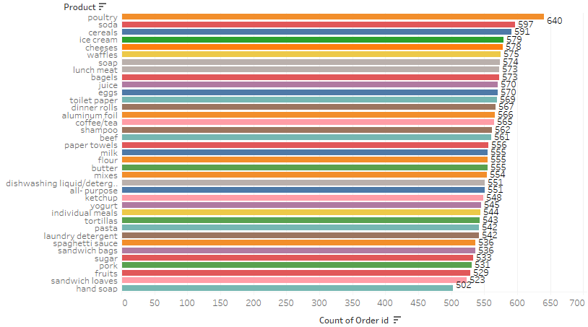

Slide 20
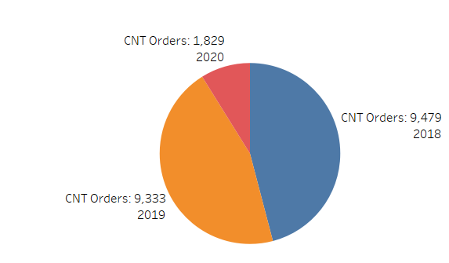
Yearly Product Sales Count
The year with the highest product sales was 2018

Slide 21
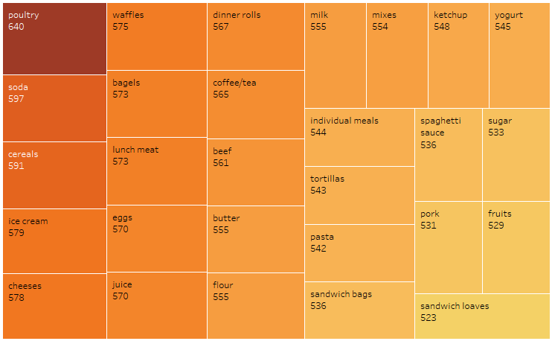
Eatable Products Sales Count:
The category contains a total of 28 products
The top-selling products are poultry, soda, and cereals.
The least sold products are pork, fruits, and sandwich loaves

Slide 22
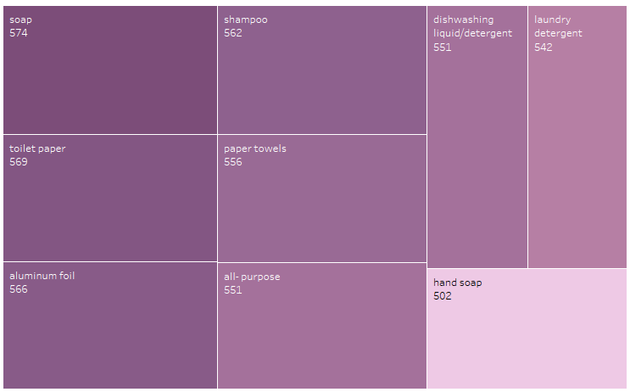
Non-Eatable Products Sales Count:
This category comprises a total of 9 products
The highest selling products in this category are soap and toilet paper.
The lowest selling product in this category is hand soap.

Slide 23
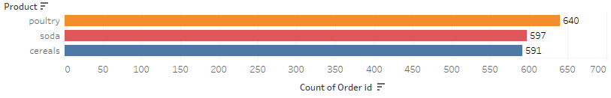
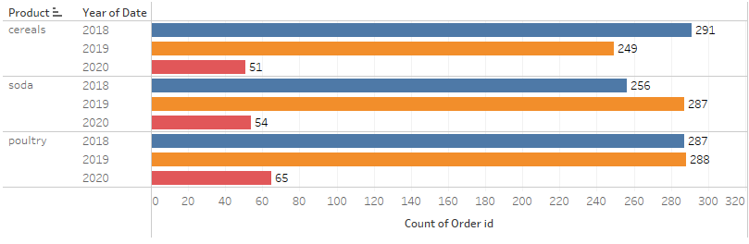
Top Three Products Over the Years
Poultry, cereals, and soda consistently emerge as the top-selling products over the years.

Slide 24
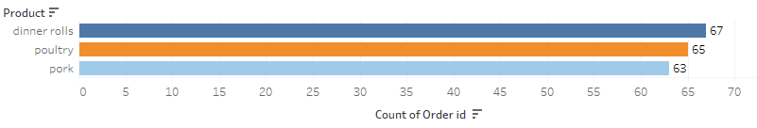
Product Sales Count in January and February 2020
The top three products sold in January and February 2020 are dinner rolls, poultry, and pork

Slide 25
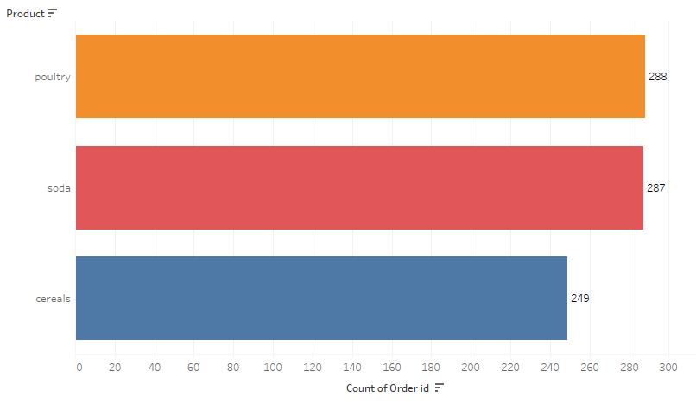
Product Sales Count in 2019
Poultry, soda, and cereal emerged as the top three products sold in 2019.

Slide 26
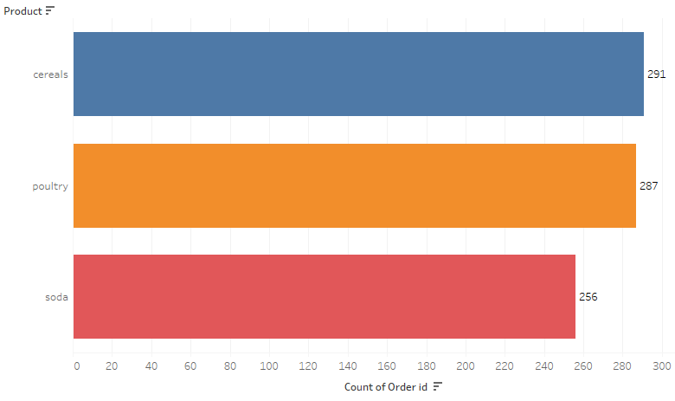
Product Sales Count in 2018
Cereals, poultry, and soda stood out as the top three products sold in 2018.

Slide 27

Summary
Cereals, poultry, and soda maintained their position as the top three products sold in both 2018 and 2019.
Dinner rolls, poultry, and pork emerged as the top three products sold in January and February 2020.
Poultry, cereals, and soda consistently rank as the most highly sold products over the years.
The highest selling products in the non-edibles category are soap and toilet paper, while hand soap is the least sold product.
The eatables category is characterized by poultry, soda, and cereals as the top-selling products, whereas pork, fruits, and sandwich loaves are among the least sold items.
Sundays registered the highest product sales, while Mondays saw the lowest sales.
In 2018, January marked the highest product sales, contrasting with February having the lowest sales. Similarly, for 2019, March experienced the highest sales, while January witnessed the lowest.
The product sales count in Q2 remains relatively consistent between the years 2019 and 2018.
The relatively low product sales count in 2020 could be attributed to the dataset's limitation, covering data only until February 26th.

Slide 28

Recommendation:
Strategically prioritize the promotion and inventory management of poultry, soda, and cereals, given their consistent track record as top-selling products..
Enhance stock levels of soap and toilet paper, recognizing their status as the most sought-after non-edible products.
Conduct a thorough analysis to understand the factors contributing to the subdued sales of hand soap and implement targeted strategies to boost its sales
Plan promotions and incentives for Sundays to capitalize on the day with the highest sales activity.
Strategically design marketing campaigns and offer discounts in February to stimulate sales during the historically sluggish month.
Strategically orchestrate marketing campaigns and offer incentives in January and March to further amplify sales during these historically robust months.
Strive to emulate the sales trends observed in Q1 2019 and Q3 2018.
Maintain a consistent product stock in Q2 to sustain sales levels aligned with previous years .
Exercise caution and account for the restricted 2020 data when formulating sales and marketing strategies.

Slide 29
03 Market Basket Analysis
Market Basket Analysis Meaning​
MRA KNIME Work Flow & Qutput Table​

Slide 30

Market Basket Analysis
Definition: Market Basket Analysis is a statistical technique that analyzes customer purchase patterns to identify associations between different products. It helps businesses understand which products are frequently purchased together and how customers' buying habits affect sales.
Data: To conduct market basket analysis, businesses need transactional data that includes details such as customer ID, product ID, and transaction date. This data is then used to create a matrix that represents the relationships between different products.
Association Rules: Association rules are used to identify the strength of the relationship between different products. These rules are expressed in terms of support, confidence, and lift. Support refers to the frequency of co-occurrence of items in a transaction, while confidence measures the probability that if a customer buys one item, they will also buy another. Lift measures the degree of correlation between two items.
Applications: Market Basket Analysis is used in a variety of industries, including retail, e-commerce, and marketing. Retailers use this technique to optimize product placement and promotions. E-commerce companies use it to personalize product recommendations, and marketers use it to develop targeted advertising campaigns.
Benefits: Market Basket Analysis helps businesses increase revenue by identifying cross-selling opportunities and developing targeted promotions. It also helps improve customer satisfaction by providing personalized recommendations and improving the overall shopping experience

Slide 31
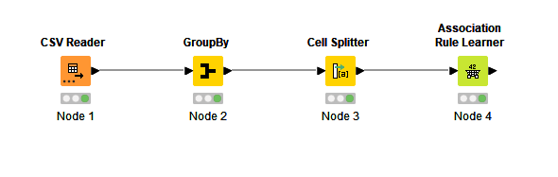
MRA KNIME Workflow

Slide 32
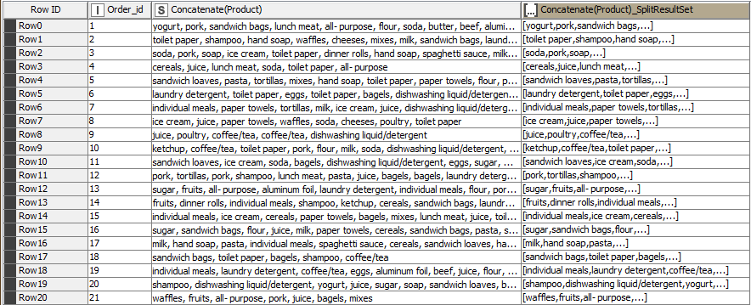
Output Table

Slide 33

Associations Identified

Slide 34
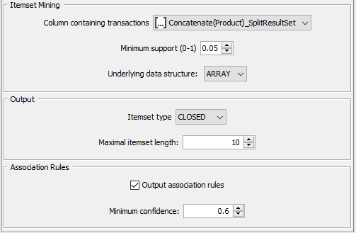
Association Rule Parameters
Support of Minimum: 0.05
Maximum Item Set Length : 10
Minimum Confidence Level:0.6

Slide 35

Market basket analysis, support, confidence, and lift values
In market basket analysis, support, confidence, and lift values are used to measure the strength of association between items in a transaction dataset.
Support: It is the probability of observing the items together in a transaction. It is calculated as the number of transactions that contain both items divided by the total number of transactions. It measures how frequent the itemset occurs in the dataset. High support indicates that the itemset is popular and should be considered for promotion or placement together.
Confidence: It is the conditional probability that a transaction containing one item also contains another item. It is calculated as the number of transactions containing both items divided by the number of transactions containing the first item. It measures the strength of the association between two items. High confidence indicates that the items are likely to be bought together, and can be used to recommend or suggest items to customers.
Lift: It is the measure of how much more often two items occur together than expected if they were independent of each other. It is calculated as the support of the itemset divided by the product of the individual supports of the items. A lift value of 1 indicates that the items are independent, while a value greater than 1 indicates a positive association between the items. A lift value less than 1 indicates a negative association between the items. High lift indicates that the items have a strong association and can be used for cross-selling or bundling.

Slide 36
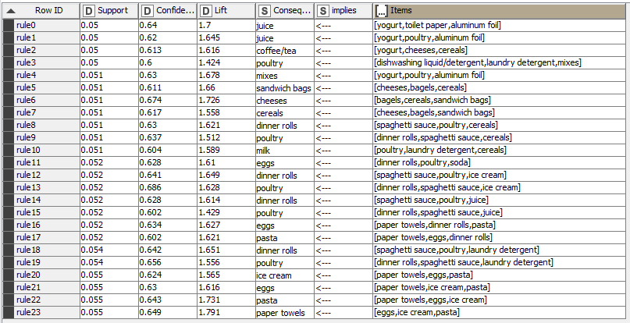
Association Rules
Association rules serve as a potent method for uncovering correlations among items within extensive datasets. These rules derive from the notion of frequent itemsets—collections of items that recurrently co-occur within transactional datasets
The dataset and specified parameters have yielded a discovery of 24 association rules.

Slide 37

Recommendation

Slide 38

Recommendations:
Introduce a compelling 'Buy Two Get One Free' promotion for yogurt, poultry, and aluminum foil, incentivizing customers to make larger purchases and enhance their shopping experience.
Craft an enticing combo offer allowing customers to enjoy cereals, bagels, and sandwich bags at a reduced price when purchased together.
Present an attractive discount on mixes for customers who choose to purchase them alongside yogurt, poultry, or aluminum foil.
Extend a special discount on dinner rolls when customers choose to purchase them in conjunction with spaghetti sauce or poultry
Unveil an enticing 'Paper Products Bundle' promotion, offering customers discounted rates when they choose to purchase paper towels, toilet paper, and tissues together
These bundled discounts and enticing combos are poised to drive higher sales by delivering enhanced value to customers while fostering increased item purchasing. Promotional efforts, including in-store signage, advertising, and social media campaigns, are pivotal in effectively communicating these offers, ensuring widespread customer awareness and engagement

Slide 39
Summary
The analysis has successfully pinpointed products frequently purchased together by customers, thereby furnishing the store with insights to strategically optimize product placement and tailor promotions for maximum effectiveness.
Yogurt, poultry, aluminum foil, cheeses, cereals, and dinner rolls emerge as some of the prominently frequented products in customer purchases.
Some product associations are intriguingly unexpected, including poultry's correlation with dishwashing liquid/detergent, laundry detergent, and mixes.
The analysis indicates that implementing discounts or enticing combos, like 'buy two get one free,' on specific products, holds the potential to motivate customers to make larger purchases.
Additionally, the store could contemplate arranging complementary products in close proximity, fostering a higher likelihood of customers making supplementary purchases.
In summary, the market basket analysis serves as a valuable tool for the store to gain deeper insights into customer behavior and preferences, enabling informed choices pertaining to product placement and promotional strategies.

Slide 40

Thank You

